Slide 1
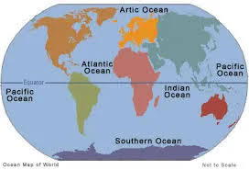


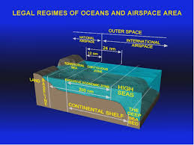
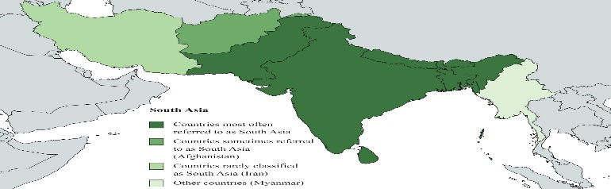
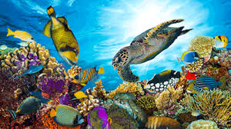
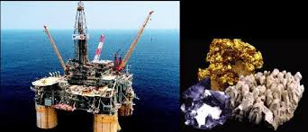
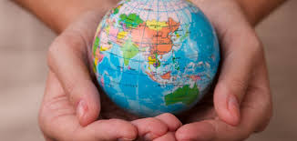
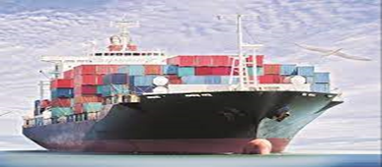
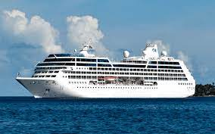
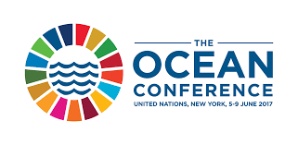
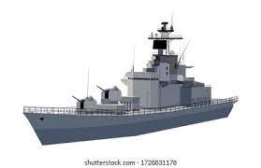
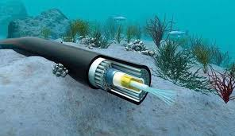
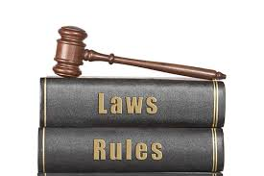
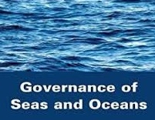
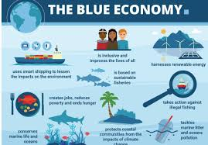
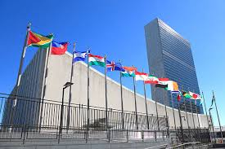
OCEANS GOVERNANCE
(COURSE PICTORIAL)

Slide 2
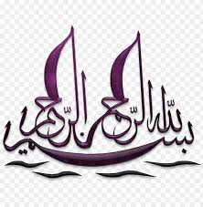


Slide 3

Introduction

Slide 4
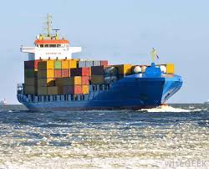
INTRODUCTION
وَهُوَ الَّذِي سَخَّرَ الْبَحْرَ لِتَأْكُلُوا مِنْهُ لَحْمًا طَرِيًّا وَتَسْتَخْرِجُوا مِنْهُ حِلْيَةً تَلْبَسُونَهَا وَتَرَى الْفُلْكَ مَوَاخِرَ فِيهِ وَلِتَبْتَغُوا مِن فَضْلِهِ وَلَعَلَّكُمْ تَشْكُرُونَ ﴿النحل: ١٤﴾
اور وہی تو ہے جس نے دریا کو تمہارے اختیار میں کیا تاکہ اس میں سے تازہ گوشت کھاؤ اور اس سے زیور (موتی وغیرہ) نکالو جسے تم پہنتے ہو۔ اور تم دیکھتے ہو کہ کشتیاں دریا میں پانی کو پھاڑتی چلی جاتی ہیں۔ اور اس لیے بھی (دریا کو تمہارے اختیار میں کیا) کہ تم خدا کے فضل سے (معاش) تلاش کرو تاکہ اس کا شکر کرو (۱۶: ۱۴)
"And it is He who subjected the sea for you to eat from it tender meat and to extract from it ornaments which you wear. And you see the ships ploughing through it, and He subjected it that you may seek of His bounty and perhaps you will be grateful.“ — Surah An-Nahl (16:14), Qur'an
This verse reflects the divine entrustment of the ocean's wealth to humanity—calling not only for use but for gratitude, stewardship, and balance

Slide 5
INTRODUCTION
Governance refers to the processes, institutions, laws, and practices through which authority is exercised, decisions are made, and accountability is ensured in the management of shared resources
In the ocean context, Ocean Governance involves international, regional, and national frameworks (laws) for the protection of, equitable sharing of, and legitimate uses of, ocean spaces and optimal utilization of ocean resources in order to ensure sustainability
Ocean Governance
Blue Economy
Resources
Challenges

Slide 6
SCHEME OF PRESENTATION
Introduction
Ocean Spaces, (Maritime Zones) (Zonal Regimes)
Resources & Uses (Blue Economy)
Responsibilities (Functional Regimes) & Challenges
Governance - Elements (Institutions, Instruments & processes)
International (United Nations, IMO) Regional & National (Pakistan)
Deficiencies & Gaps
Way Forward & Conclusion

Slide 7
Ocean Spaces (Maritime Zones) (Zonal Regimes)

Slide 8
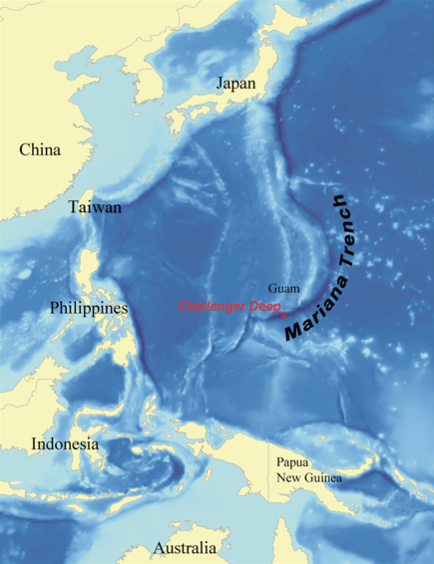
EARTH’S SURFACE - OCEANS & SEAS
Total Area of Earth: 510.1 million km²
Land Area: 148.9 million km² → 29.2% of Earth's surface
Area of Oceans & Seas: 361.2 m km² → 70.8% of Earth's surface
Volume of Oceans & Seas: 1.332 billion cubic kilometers
07 Oceans (05 recognized by IHO) and around 60 seas
Pacific Ocean, Atlantic Ocean, Indian Ocean, Southern Ocean (Antarctic Ocean) & Arctic Ocean
Deepest Point - Mariana Trench (Marianas Trench) Pacific Ocean
Depth: 10,984 meters (36,037 feet / 6.825 miles)
Depth comparable to height of Earth's atmosphere's lower limit (troposphere)
About 97% of Earth’s water is in oceans

Slide 9
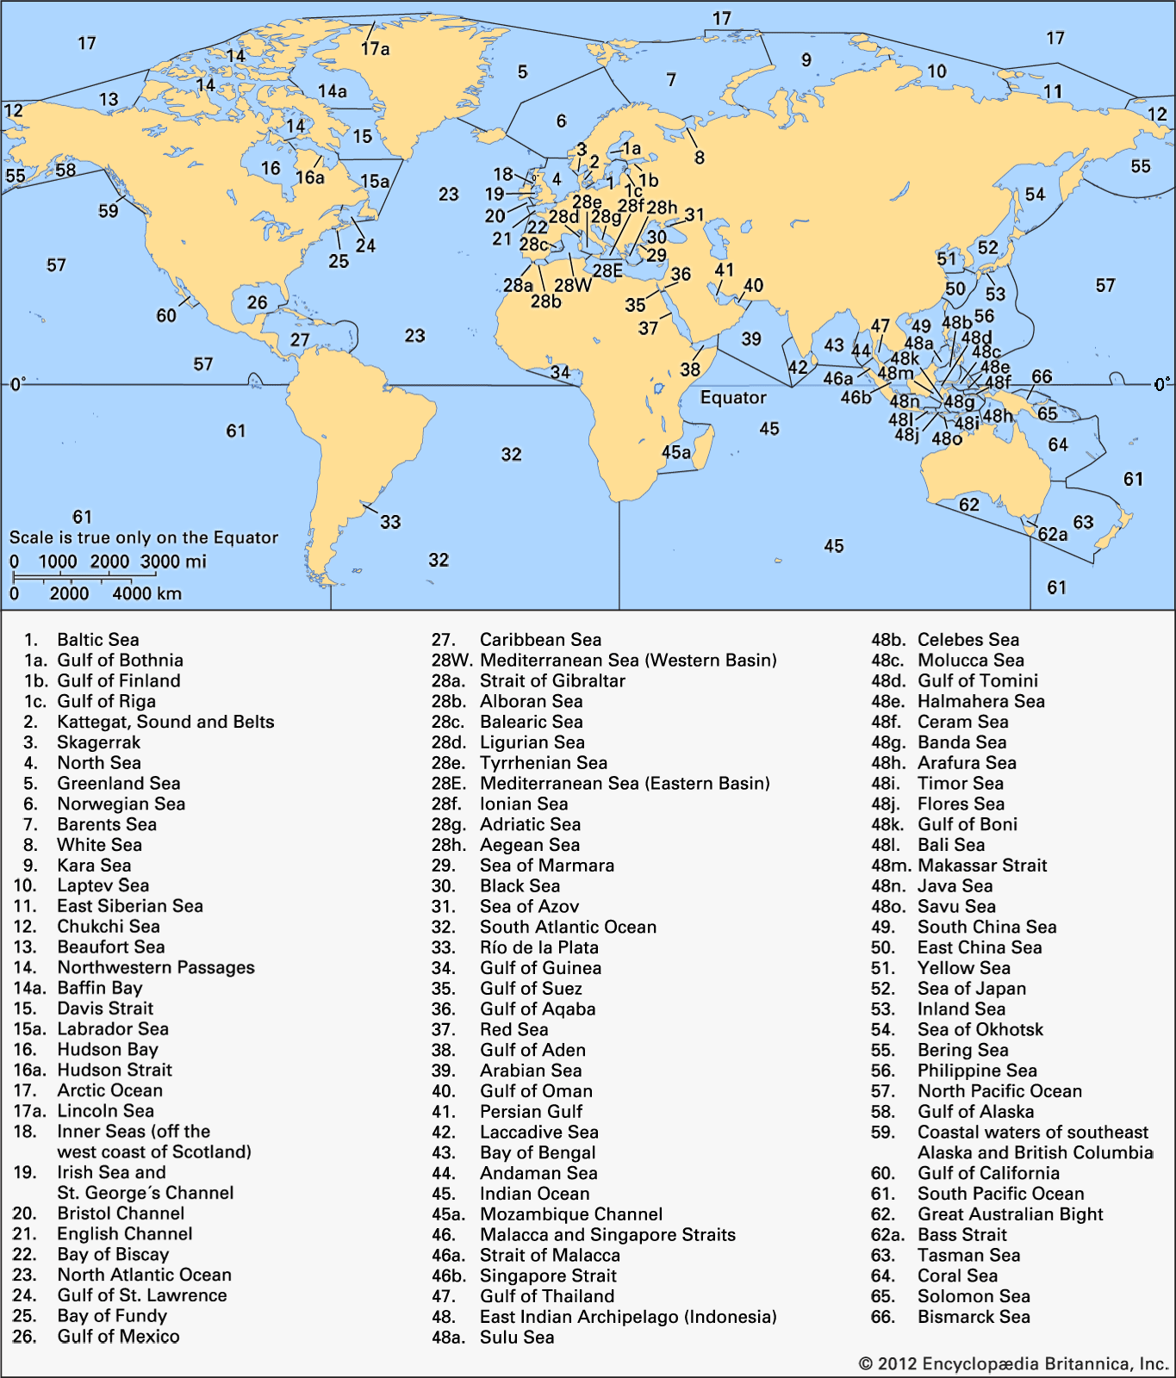
OCEANS & SEAS

Slide 10

OCEANS & SEAS
Ocean | Area (approx.)
Pacific Ocean | 165.25 million km² (largest) (Larger than Land Area)
Atlantic Ocean | 106.46 million km²
Indian Ocean | 70.56 million km²
Southern (Antarctic) Ocean | 21.96 million km²
Northern (Arctic) Ocean | 14.06 million km² (smallest)

Slide 11
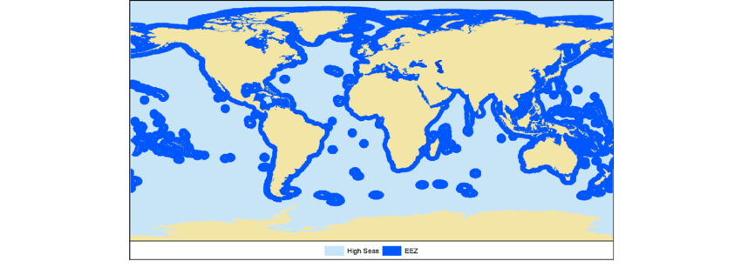
AREAS UNDER NATIONAL JURISDICTION & ABNJ
Areas Under National Jurisdiction
25.5 % of Earth & 36 % of Oceans
Areas Beyond National Jurisdiction
45.3 % of Earth and 64 % of Oceans

Slide 12

MARITIME ZONES

Slide 13
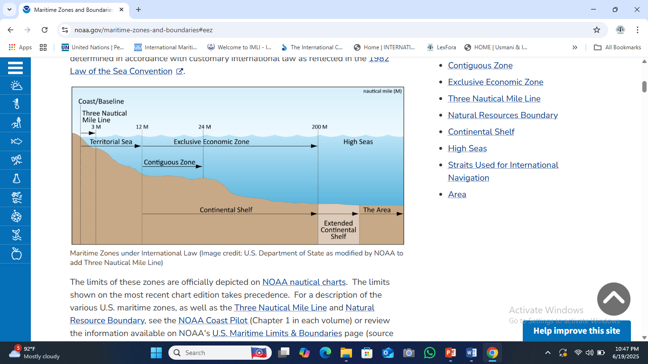
MARITIME ZONES
Sea-bed
&
Subsoil

Slide 14
MARITIME ZONES
Maritime Zone / Area | Estimated Area Covered
Internal Waters | ~2.5 million km²
Territorial Sea | ~15 million km²
Contiguous Zone (12–24 nm) | Included in EEZ
Exclusive Economic Zones (EEZs) | ~137 million km²
Continental Shelf (up to 350 nm) | ~52 million km²
High Seas | ~230 million km²
International Seabed Area (The Area) | ~55 million km²

Slide 15
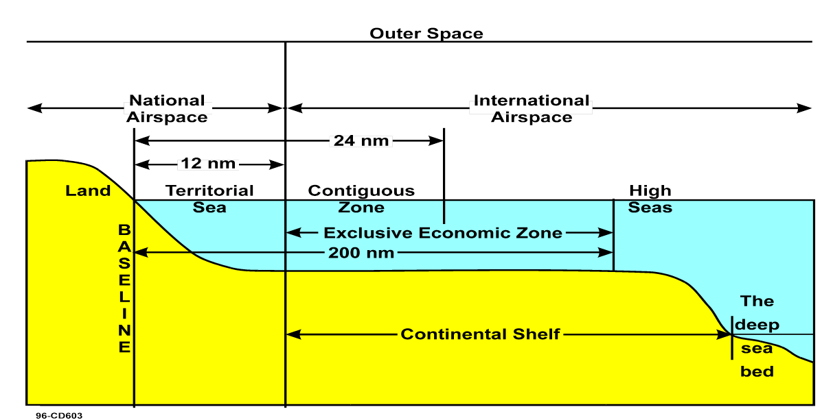
GEOGRAPHICAL REGIMES
Coast Line and Base Lines
Internal Water
Archipelagic Waters
Territorial Sea
Contiguous Zone
Exclusive Economic Zones
Continental Shelf
High Seas
International Sea Bed Area (AREA)
International Straits
Closed and Semi Closed Seas
Islands and Artificial Islands
Ice Covered Areas
Can be extended upto 350 NM

Slide 16
Ocean Resources

Slide 17
OCEANS RESOURCES
Living
Non-Living
Non-Natural
Natural
Scenic & Ecosystem Value

Slide 18
LIVING RESOURCES
Fish and Shellfish:
Marine Mammals:
Marine Plants and Algae:
Coral Reefs and Reef Organisms:
Planktonic Life:
Bacteria:
Archaea:
Marine Birds (dependent on ocean ecosystems):
Genetic Resources:

Slide 19
LIVING RESOURCES
Fish and Shellfish:
230,000 species, including Pelagic fish (tuna, mackerel, sardines), Demersal fish (cod, haddock, flounder), Crustaceans (shrimp, crab, lobster) and Mollusks (octopus, squid, oysters, mussels, clams)
Marine Mammals:
Whales, Dolphins, Seals, Sea lions, Dugongs and Manatees
Marine Plants and Algae:
Sea grasses, Mangroves (in coastal zones), Macroalgae (seaweed such as kelp, red and green algae), Microalgae (phytoplankton, important for oxygen production and food webs)
Coral Reefs and Reef Organisms:
Coral polyps (living animals forming coral reefs), Symbiotic algae (zooxanthellae), Reef-associated fish and invertebrates
Planktonic Life:
Phytoplankton (plant-like microscopic organisms; base of marine food chain), Zooplankton (animal plankton; includes larvae, krill, copepods)
Bacteria: ubiquitous single-celled prokaryotes
Archaea: prokaryotes distinct from bacteria, that inhabit many environments of ocean
Marine Birds (dependent on ocean ecosystems):
Albatrosses, Puffins, Penguins, Gulls and terns,
Genetic Resources:
Marine organisms with potential for biotechnology, pharmaceuticals, and industrial applications, e.g.: Enzymes from extremophiles, Bioactive compounds from sponges, tunicates, and deep-sea organisms

Slide 20
LIVING RESOURCES
Anadromous Stocks - Adult fish live in salt water (sea) and migrate into fresh water to spawn
Catadromous Species - Adult fish live in fresh water and migrate into salt water to spawn
Sedentary Species - Living natural resources of continental shelf – which either are immobile on or under seabed or unable to move except in constant physical contact with seabed or subsoil
Straddling Stocks - Fish stocks that migrate through, or occur in, more than one exclusive economic zones
Highly Migratory Species – Highly migratory fish almost travels around the globe

Slide 21
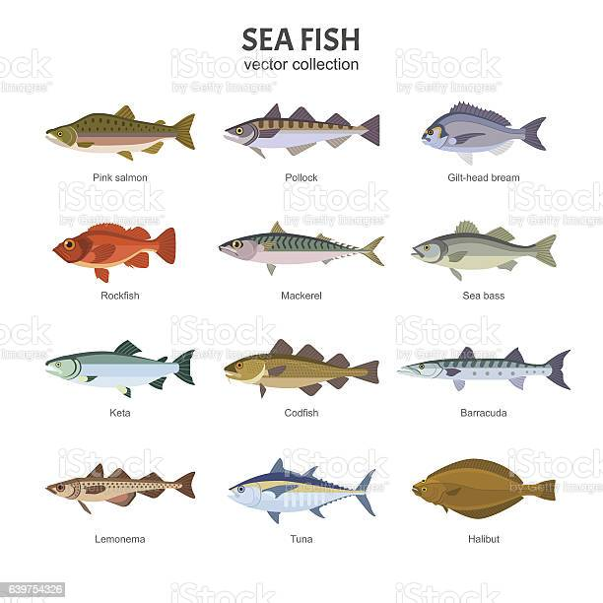
LIVING RESOURCES
HIGHLY MIGRATORY SPECIES
1. Albacore tuna: Thunnus alalunga.
2. Bluefin tuna: Thunnus thynnus.
3. Bigeye tuna: Thunnus obesus.
4. Skipjack tuna: Katsuwonus pelamis.
5. Yellowfin tuna: Thunnus albacares.
6. Blackfin tuna: Thunnus atlanticus.
7. Little tuna: Euthynnus alletteratus; Euthynnus affinis.
8. Southern bluefin tuna: Thunnus maccoyii.
9. Frigate mackerel: Auxis thazard; Auxis rochei.
10. Pomfrets: Family Bramidae.
11. Marlins: Tetrapturus angustirostris; Tetrapturus belone; Tetrapturus pfluegeri; Tetrapturus albidus.
12. Sail-fishes: Istiophorus platypterus; Istiophorus albicans.
13. Swordfish: Xiphias gladius.
14. Sauries: Scomberesox saurus; Cololabis saira; Cololabis adocetus; Scomberesox saurus scombroides.
15. Dolphin: Coryphaena hippurus; Coryphaena equiselis.
16. Oceanic sharks: Hexanchus griseus; Cetorhinus maximus; Family Alopiidae; Rhincodon typus.
17. Cetaceans: Family Physeteridae; Family Balaenopteridae; Family Balaenidae; Family Eschrichtiidae.

Slide 22
LIVING RESOURCES
Key Facts About Oceans, Fisheries & Marine Economy (2024 Update)
Global fish production (capture + aquaculture) reached over 184 million tonnes
Aquaculture now accounts for over 50% of fish consumed globally
Global seafood market valued $257 billion (2022), projected $350 billion (2027)
Marine & coastal resources contribute $3 trillion annually to global economy
Blue Economy represents 5% of global GDP, with vast untapped potential
Over 600 million people depend on fisheries and aquaculture
Women account for about 50% of workforce in post-harvest fisheries
Seafood provides about 17% of global animal protein consumption
In some coastal & island states, seafood accounts for over 50% of animal protein
In 2020, world had 4.1 million fishing vessels

Slide 23
NON-LIVING (NATURAL) RESOURCES
Hydrocarbons – Oil & Natural Gas
Oceans contribute 30% of global oil and 27% of global natural gas production
As of 2024, global oil production is approx 101 million barrels per day
Gases (Produced, Absorbed, or Stored)
Oceans produce over 50% of Earth’s oxygen, primarily through phytoplankton
They absorb about 25–30% of global CO₂ emissions annually
Minerals & Salts
Iron, Aluminum, Manganese, Cobalt, Nickel, Copper, Rare Earth Elements (REEs), Sand, Gravel, Silicon, Sulfate, Potassium, Magnesium, Sodium, Calcium, Chloride
Marine salts and brine resources are widely extracted (e.g., Sodium Chloride)
Coral reefs: also considered non-living carbonate structures with ecological value
Water (Desalination):
Oceans provide a key source of freshwater in over 120 countries.
Energy Potential:
Tidal, Wave, Ocean Thermal Energy Conversion (OTEC) and Salinity Gradient Energy
Offshore wind energy capacity reached 64.3 GW globally in 2023, led by China, UK, and Germany
Climate Buffer Function:
Oceans regulate global climate by heat absorption and redistribution

Slide 24
NON-LIVING (NON NATURAL) RESOURCES
Man-made assets in marine environment, often governed by maritime law. Have strategic, economic, legal value
Shipwrecks & Maritime Properties (Subject to Salvage Laws):
Shipwrecks, sunken cargo, aircraft; Jetsam; Flotsam; Derelict (abandoned vessels or property)
Artificial Islands:
Land masses constructed for Tourism, Urban expansion, Military or commercial bases
Artificial Installations & Structures:
Oil platforms, Floating storage units (FSUs), Offshore wind turbines, Research stations for energy extraction, defense and surveillance
Submarine Pipelines & Cables:
Over 1.4 million kilometers of active undersea cables (telecom, internet, power) Pipelines also carry gas and oil across seas
Marine Waste Dumping Grounds:
Industrial or military waste disposal, Decommissioned equipment or munitions, carbon dioxide storage (CCS)
These non-natural marine resources form an essential part of modern ocean use and governance. They must be managed through international law, environmental safeguards, and sustainable marine spatial planning

Slide 25
Oceans’ Uses

Slide 26
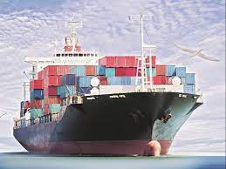
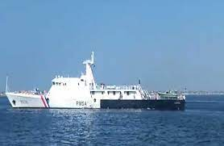
USES OF OCEANS & SEAS
Medium of Navigation and Trade
Shipping for Commerce and Tourism
Political, Military, and Strategic Uses
a) Law Enforcement & Maritime Security
b) Naval Maneuvers & Weapons Testing
c) Military Presence and Deterrence
d) Combat and Logistics
e) Protection of Sea Frontiers
Marine Waste Dumping Grounds

Slide 27
USES OF OCEANS & SEAS
Medium of Navigation and Trade
Over 95% of global trade by volume is carried by sea
Oceans are the cheapest and most efficient mode of transport for bulk goods.
Global merchant fleet comprises approximately: 36,299 cargo ships, 16,560 tankers, Total: 52,859 commercial vessels
Ports, straits, and shipping lanes (e.g., Suez, Panama, Malacca) are vital trade arteries.
Shipping for Commerce and Tourism
Passenger ships, cruise liners, and ferries are used for: International tourism, Island connectivity, Pilgrimages and recreational voyages. As of 2023, there are about 5,369 active passenger vessels worldwide (including cruise ships and ferries). Cruise tourism alone contributes over $150 billion annually to the global economy.
Political, Military, and Strategic Uses
Oceans are crucial to projecting and protecting a state's sovereign power and defense interests.
a) Law Enforcement & Maritime Security. Naval forces, coast guards, and maritime police patrol: Exclusive Economic Zones (EEZs), Territorial waters, High-risk zones (piracy, smuggling, IUU fishing). Enforcement of laws related to customs, immigration, fisheries, and pollution.
b) Naval Maneuvers & Weapons Testing. Oceans provide secure space for naval exercises, missile testing, and sonar/radar experiments. High seas are often used for strategic weapon calibration, including submarine drills and ballistic missile tests.
c) Military Presence and Deterrence. Displaying naval force is a tool for: Power projection, Regional influence, Crisis response, Rapid deployment in conflict zones
d) Combat and Logistics. Seas are used for: Conduct of naval warfare, Amphibious landings, Mine warfare and blockade operations, Underway replenishment and naval logistics support
e) Protection of Sea Frontiers. Integral to defending maritime borders, exclusive zones, and critical undersea infrastructure (like data cables and pipelines).

Slide 28
SCENIC - RECREATIONAL VALUE OF OCEANS
Oceans and seas are not just ecological powerhouses but also major contributors to human well-being, cultural identity and global economy through their scenic and recreational value
Aesthetic and Cultural Significance
Quranic reference
Tourism and Coastal Recreation
Sports and Leisure Activities
Marine Ecotourism
Economic and Educational Opportunities

Slide 29
SCENIC - RECREATIONAL VALUE OF OCEANS
Oceans and seas are not just ecological powerhouses but also major contributors to human well-being, cultural identity and global economy through their scenic and recreational value
Aesthetic and Cultural Significance
Visual beauty of coastlines, coral reefs, beaches, and marine biodiversity inspires art, literature, music, and spirituality across civilizations. Coastal and island communities have deep-rooted cultural and spiritual connections
Quranic reference: "And it is He who has subjected the sea for you to eat from it tender meat and to extract from it ornaments which you wear...” — Surah An-Nahl (16:14)
Tourism and Coastal Recreation
Marine and coastal tourism generates over 1 trillion US$ annually, providing millions of jobs in: Beach resorts, cruise lines, diving, snorkeling, fishing charters, boating and ecotourism. More than 60% of international tourists visit coastal areas
Sports and Leisure Activities
Popular water-based recreational activities: Swimming, surfing, sailing, scuba diving, snorkeling, yachting, jet skiing, deep-sea fishing. These activities promote physical health, mental well-being, and are part of blue economy
Marine Ecotourism
Activities like whale watching, sea turtle conservation, mangrove walks, coral reef safaris, etc support conservation efforts while educating public
Economic and Educational Opportunities
Coastal recreation drives hospitality, transport, education, real estate, and research sectors
Offers platforms for marine education, public awareness and engagement with ocean governance and sustainability

Slide 30
Responsibilities (Functional Regimes) & Challenges

Slide 31
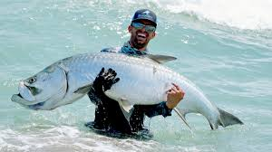
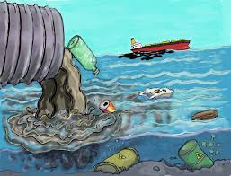
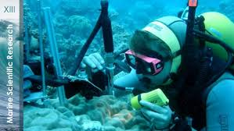
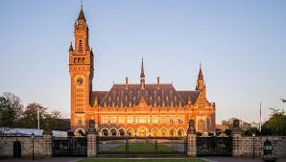
OBLIGATIONS (FUNCTIONAL REGIMES)
To undertake fishing
To Conserve Living Resources
To Explore & Exploit Non-Living Resources
To use Seas equitably for Artificial Islands, Installations, Submarine Cables and other uses of seas
To promote Safe Secure Shipping & Related activities
To maintain Conducive Marine Environment
To undertake befitting Marine Scientific Research
To Protect through Enforcement &
To resolve disputes through Pacific means

Slide 32
CHALLENGES TO OCEANS’ GOVERNANCE
Illegal, Unlawful and Unregulated Fishing
Inequitable Exploitation of Marine Resources both Living and Non-Living
Environmental Impact: Marine Pollution, Habitat Degradation and Loss, Climate Change Impacts, Introduction of Invasive Alien Species and Impacts from Resource Exploitation
Unsafe Shipping and Unsafe Ports: Vessel Safety, Port Safety and Security
Lack of Marine Scientific Research & Maritime Education
Human Activities - Dredging, Ship Wrecks & Abandoned Properties (Jetsam)
Non-settlement of Disputes on Delimitation of Maritime Boundaries

Slide 33
CHALLENGES TO OCEANS’ GOVERNANCE
Illegal, Unlawful and Unregulated Fishing: Illegal, Unlawful, Unregulated Fishing, Overfishing, unauthorized nets and Destructive Fishing Practices (Blast Fishing, Cyanide Fishing, Ghost Fishing) Impacts: Ecological, Economic, Social, Governance.
Inequitable Exploitation of Marine Resources both Living and Non-Living: Living Marine Resources: Fisheries, Disparity in Access, Benefit Sharing, Stock Depletion, Marine Genetic Resources (MGRs), Bio prospecting, Benefit Sharing Controversy
Non-Living Marine Resources: Hydrocarbons (Oil & Gas), Resource Nationalism, Environmental Risk vs. Economic Gain, Benefit Distribution. Deep-Sea Minerals (DSM): Types, Access and Technology Gap, International Seabed Authority (ISA), "Common Heritage of Mankind" Principle, Sand and Gravel, Coastal Mining. Overall Impacts:
Environmental Impact: Marine Pollution: Oil Spills, Plastic Pollution, Chemical Pollution, Noise Pollution, Sewage and Greywater. Habitat Degradation and Loss: Dredging, Land Reclamation, Coastal Erosion, Ship Wrecks and Abandoned Properties (Jetsam etc.). Climate Change Impacts (exacerbated by maritime activities): Ocean Acidification, Sea-Level Rise and Changes in Ocean Currents and Temperatures. Introduction of Invasive Alien Species: Ballast Water, Bio fouling. Impacts from Resource Exploitation: Overfishing and Destructive Fishing Practices, Offshore Mining and Drilling.
Unsafe Shipping and Unsafe Ports: Vessel Safety: Substandard Vessels, Lack of Proper Certification and Inspection, Human Error, Navigational Hazards, Cargo Mismanagement, and Outdated Technology
Port Safety and Security: Inadequate Infrastructure, Poor Cargo Handling Practices, Insufficient Security Measures, Congestion and Traffic Management, Lack of Emergency Preparedness, and Environmental Risks: Security Concerns like Piracy, Terrorism and other Crimes at Sea: Smuggling, Human Trafficking/Irregular Migration: Illegal, Unreported, and Unregulated (IUU) Fishing, Stowaways, Cyber Attacks, Fraud and Extortion

Slide 34
CHALLENGES TO OCEANS
Lack of Marine Scientific Research & Maritime Education:
Lack of Marine Scientific Research (MSR): Funding Shortages, Technological Gaps, Capacity Building, Data Deficiencies, Fragmented Research Efforts, Access to Research Areas:
Lack of Maritime Education: Insufficient Training Facilities, Curriculum Gaps, Shortage of Qualified Instructors, Brain Drain, Awareness Deficit, Access Barriers:
Human Activities - Dredging, Ship Wrecks & Abandoned Properties (Jetsam etc):
Dredging: Impacts - Habitat Destruction, Sediment Plumes, Noise and Vibration, Changes in Hydrodynamics, Resuspension of Pollutants, Disposal Issues.
Ship Wrecks: Impacts - Pollution Source, Physical Hazards, Habitat Alteration, Ghost Fishing, Salvage Operations.
Abandoned Properties (Jetsam, Flotsam, Lagan, Derelict): Impacts - Marine Pollution, Navigational Hazards, Ghost Fishing, Economic Costs, Environmental Degradation,
Disputes on Delimitation of Maritime Boundaries:
Key Maritime Zones under UNCLOS: Territorial Sea, Contiguous Zone, Exclusive Economic Zone (EEZ), Continental Shelf
Causes of Disputes: Overlapping Claims, Interpretation of UNCLOS, Resource Potential, Strategic Importance, Historical Claims, Lack of Demarcation, Geopolitical Hotspots, South China Sea, East China Sea, Arctic Ocean, Mediterranean Sea, Indian Ocean.
Impacts: - Increased Tensions and Conflict, Hindered Resource Management, Economic Stagnation, Environmental Degradation, Obstruction of Scientific Research, Challenge to International Law.
Resolution Mechanisms: Bilateral Negotiations, International Court of Justice (ICJ), International Tribunal for the Law of the Sea (ITLOS), Arbitration, Joint Development Agreements.

Slide 35

CHALLENGES TO OCEANS - SOLUTION
OCEANS GOOD GOVERNANCE

Slide 36
Governance - Elements (Institutions, Instruments & Processes)

Slide 37
OCEANS’ GOVERNANCE
Ocean Governance involves international, regional, and national frameworks (institutions, instruments & processes) for the protection of, equitable sharing of and legitimate uses of ocean spaces and optimal utilization of ocean resources, in order to ensure sustainability (Blue Economy)

Slide 38
ELEMENTS OF GOVERNANCE
Elements of
Governance
Institutions
(Organizations)
Instruments
(Laws)
Processes (Policies/Initiatives)
International (Policy Development & Agenda Setting)
Regional (Institutional Strength & Capacity Building)
National (Implementation - Prescription & Enforcement)

Slide 39
Governance - Elements Instruments

Slide 40
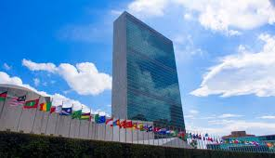
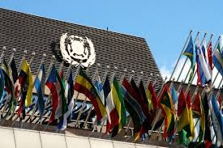
INSTITUTIONS
There are two major international legal institutions or organizations involved in ocean governance
The United Nations Organization (UNO), and
The International Maritime Organization (IMO)
Other international or global organizations are:
ILO, WHO, World Ocean Council & many more

Slide 41
ROLE OF UN ORGANS IN OCEAN GOVERNANCE
General Assembly (UNGA):
Policy forum for ocean affairs through annual resolutions under "Oceans and the Law of Sea"
Established UN Open-ended Informal Consultative Process on Oceans and Law of Sea (UNICPOLOS)
Oversees implementation of UNCLOS and emerging agreements like BBNJA
Security Council:
Addresses threats to international peace from maritime issues, e.g., piracy off Somalia
Can authorize naval operations or sanctions in maritime zones when peace and security are at risk
Economic and Social Council (ECOSOC):
Coordinates work of specialized agencies & commissions on ocean-related sustainable development SDG-14
Engages in capacity building, science-policy dialogue, and funding coordination
Trusteeship Council (inactive since 1994):
Historically oversaw trust territories, including governance of their coastal and marine resource
International Court of Justice (ICJ):
Settles disputes between states related to maritime boundaries, resource rights, and navigation
Contributes to jurisprudence on ocean law, e.g., Nicaragua v. Colombia (2012), Qatar v. Bahrain (2001)
Secretariat (UN Division for Ocean Affairs and the Law of Sea - DOALOS)
Provides technical, legal, and administrative support on UNCLOS implementation, Coordinates meetings, reports, and treaty processes

Slide 42
INSTITUTIONS – UN SPECIALIZED AGENCIES
FAO – Food and Agriculture Organization: Plays a key role in ocean governance through fisheries and aquaculture management, Leads efforts against IUU (Illegal, Unreported, Unregulated) fishing, marine ecosystem protection, and responsible seafood practices (e.g., Code of Conduct for Responsible Fisheries)
ICAO – International Civil Aviation Organization: While focused on air transport, it supports air-sea rescue coordination, aerial surveillance over maritime zones, and links to maritime logistics
IFAD – International Fund for Agricultural Development: Supports coastal and small island communities in adapting to climate change, improving livelihoods through fisheries and coastal agriculture projects
ILO – International Labour Organization: Sets and monitors maritime labor standards, including the Maritime Labour Convention (MLC), 2006. Protects rights of seafarers, port workers, and fishers, promoting decent work in maritime sectors
IMF – International Monetary Fund: Provides financial support to states facing economic challenges, including small island developing states (SIDS) vulnerable to ocean-related economic shocks. Encourages investment in blue economy sectors for sustainable growth

Slide 43
INSTITUTIONS – UN SPECIALIZED AGENCIES
IMO – International Maritime Organization: A core ocean governance body, responsible for creating and enforcing a comprehensive legal and regulatory framework for: Maritime safety (e.g., SOLAS), Marine pollution prevention (MARPOL), Liability and compensation regimes (CLC & FUND), Maritime security (e.g., ISPS Code), Seafarer training (STCW Convention) and Green shipping and decarbonization efforts
ITU – International Telecommunication Union: Regulates maritime communication systems, including distress and safety communications (GMDSS). Coordinates use of radio frequencies essential for marine navigation, weather forecasts, and vessel tracking
UNESCO – United Nations Educational, Scientific and Cultural Organization: Through IOC (Intergovernmental Oceanographic Commission), leads global ocean science cooperation, marine data sharing, and the UN Ocean Decade (2021–2030). Protects underwater cultural heritage and World Heritage coastal/marine sites
UNIDO – United Nations Industrial Development Organization: Supports blue economy development through sustainable marine industries, waste reduction in coastal zones, and green port initiatives

Slide 44
INSTITUTIONS – UN SPECIALIZED AGENCIES
UNWTO – World Tourism Organization: Promotes sustainable coastal and maritime tourism, especially in SIDS and ecologically sensitive marine areas. Advocates for policies that balance tourism with marine conservation.
UPU – Universal Postal Union: While primarily focused on postal services, contributes indirectly to ocean governance via global trade facilitation and supply chain connectivity, including island and coastal regions
WHO – World Health Organization: Addresses marine and coastal health risks, such as waterborne diseases, seafood safety, and pollution impacts on health. Coordinates global response to health emergencies in maritime settings
WIPO – World Intellectual Property Organization: Protects IP related to marine biotechnology, blue tech innovations, and indigenous knowledge associated with ocean use
WMO – World Meteorological Organization: Vital for ocean governance through marine meteorology, tsunami warning systems, climate modeling, and sea-level rise monitoring. Supports navigation safety through real-time ocean weather services
World Bank: Major financier of blue economy projects, marine pollution reduction, and coastal infrastructure. Supports marine spatial planning, fisheries reforms, and climate adaptation in developing and coastal states

Slide 45
INSTITUTIONS - OTHER UN ENTITIES & BODIES
UNAIDS – Joint United Nations Programme on HIV/AIDS: While primarily focused on public health, it contributes to resilience-building in vulnerable coastal communities, especially in regions where health challenges intersect with poverty and environmental. Also indirectly contributes to SDG 14 (Life Below Water) by improving human well-being in coastal areas
UNHCR – United Nations High Commissioner for Refugees: Addresses displacement due to sea-level rise, marine disasters, and coastal conflict. Increasingly involved in protecting climate-induced refugees from small island states and low-lying coastal zones
UNIDIR – United Nations Institute for Disarmament Research: While focused on disarmament, its work on maritime security risks, including military buildup in disputed maritime zones, contributes to peaceful ocean governance and conflict prevention
UNITAR – United Nations Institute for Training and Research: Offers training in ocean law, climate resilience, disaster response, and sustainable development for coastal and island states. Builds capacity of developing countries to engage in maritime negotiations and treaty implementation

Slide 46
INSTITUTIONS - OTHER UN ENTITIES & BODIES
UNOPS – United Nations Office for Project Services: Implements infrastructure and environmental projects in coastal areas, including climate-resilient ports, water systems, and waste management in SIDS and LDCs. Supports logistics for humanitarian operations in maritime regions prone to disasters
UNRWA – United Nations Relief and Works Agency for Palestine Refugees in the Near East: Operates in coastal areas like Gaza, providing services that intersect with marine resource access, health, and environmental issues. Supports sustainable livelihoods for refugees in maritime zones.
UNSSC – United Nations System Staff College: Develops and delivers training on UN ocean mandates, SDG 14, and inter-agency coordination in ocean governance efforts. Supports capacity-building on climate, resilience, and blue economy strategies
UNU – United Nations University: Through institutes like UNU-INWEH (Water, Environment and Health) and UNU-EHS (Environment and Human Security), conducts research on: Coastal vulnerability and adaptation; Ocean-climate-human interactions; Marine ecosystem governance; Provides evidence-based recommendations for policies on ocean sustainability and resilience
UN Women (UNW): Promotes gender equality in ocean sectors, including fisheries, maritime transport, port operations, and coastal governance. Supports inclusion of women in blue economy policymaking, and addresses gendered impacts of climate change in coastal regions.

Slide 47
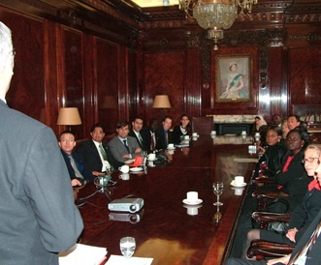
INSTITUTIONS - IMO
IMO BUILDING
IMO
CONFERENCE ROOM

Slide 48
INSTITUTIONS - IMO
International Maritime Organization (IMO): Nexus with Ocean Governance
Creation of IMO stemmed from post-war recognition of the need to enhance safety at sea and establish uniform international maritime regulations
IMO Convention (1948) entered into force in 1958
Article 1(a) defines IMO’s purpose:
“To provide machinery for cooperation among governments on regulation and practices affecting international shipping, and to promote the adoption of the highest practicable standards in maritime safety, efficiency of navigation, and prevention/control of marine pollution from ships.”
Also empowered to address legal, technical, environmental, and administrative matters in its domain

Slide 49
INSTITUTIONS – IMO STRUCTURE
Assembly: Supreme decision-making body of all Member States (meets biennially)
Council: Elected by Assembly; acts as executive organ between Assembly sessions
Five Main Committees:
Maritime Safety Committee (MSC) – addresses ship safety, navigation, accident investigation, dangerous cargoes, etc
Marine Environment Protection Committee (MEPC) – focuses on pollution prevention and marine environmental protection
Legal Committee – formulates and reviews conventions on liability, compensation, piracy, etc
Facilitation Committee (FAL) – simplifies documentation and clearance in maritime traffic
Technical Cooperation Committee (TCC) – builds capacity in developing countries for maritime governance
Sub-Committees under MSC & MEPC

Slide 50
INSTITUTIONS – IMO COMMITTEES
MSC and MEPC Sub-Committees
Sub-Committee on Human Element, Training and Watchkeeping (HTW);
Sub-Committee on Implementation of IMO Instruments (III);
Sub-Committee on Navigation, Communications and Search and Rescue (NCSR);
Sub-Committee on Pollution Prevention and Response (PPR);
Sub-Committee on Ship Design and Construction (SDC);
Sub-Committee on Ship Systems and Equipment (SSE); and
Sub-Committee on Carriage of Cargoes and Containers (CCC)

Slide 51
Governance - Elements Instruments

Slide 52
INSTRUMENTS - UNO
Instruments created under auspices of UNO are:
1958 Convention on Territorial Sea and Contiguous Zone
1958 Convention on Continental Shelf
1958 Convention on High Seas
1958 Convention on Fishing & Conservation of Living Resources of High Seas
1982 Law of the Sea Convention (UNCLOS)
1994 Agreement relating to Implementation of Part XI of UNCLOS (ISBA)
1995 Agreement on Conservation of Straddling Stocks & Highly Migratory Stocks
2023 Agreement on the conservation and sustainable use of marine biological diversity of areas beyond national jurisdiction under

Slide 53
INSTRUMENTS - UNO
United Nations Instruments and the Good Governance of Oceans
1958 Geneva Conventions on the Law of the Sea set foundations for crystalizing and codifying Oceans spares, rights over resources, and Jurisdictions as well as predictability in ocean governance
Territorial Sea and Contiguous Zone. Recognized coastal state sovereignty in adjacent waters, enabling law enforcement and regulatory control close to shore
Continental Shelf. Asserted rights over seabed resources, laying the basis for resource jurisdiction under legal principles rather than mere exploitation
High Seas. Codified freedoms (navigation, fishing, overflight), helping establish non-exclusionary use and the need for shared responsibility
Fishing and Conservation. Introduced the principle of international cooperation for resource conservation as well as an early form of environmental stewardship

Slide 54
INSTRUMENTS - UNO
1982 United Nations Convention on the Law of the Sea (UNCLOS)
"A Constitution for the Oceans" — Holistic Ocean Governance Framework
UNCLOS consolidated and modernized maritime law, setting a comprehensive legal order for oceans. It is the cornerstone of ocean governance, offering:
Zonal clarity: Defined maritime zones (Territorial Sea, EEZ, Continental Shelf, High Seas) and respective jurisdictional rights
Balance of interests: Combined coastal state rights with freedoms of navigation and global commons.
Institutional mechanisms: Created bodies like the International Seabed Authority (ISBA) and the International Tribunal for the Law of the Sea (ITLOS), enhancing global compliance and dispute resolution
Environmental governance: Obligated states to prevent marine pollution and promote sustainable use of resources.
Equity and technology: Emphasized equitable access, capacity-building, and technology transfer, especially for developing states

Slide 55
INSTRUMENTS - UNO
1994 Agreement Relating to the Implementation of Part XI of UNCLOS (ISBA)
It made Deep Seabed Governance Functional and Inclusive
This Agreement also operationalized deep seabed mining in a way that upheld equitable access, environmental safeguards, and fair participation
Reformed decision-making in ISBA to reflect inclusive governance.
Balanced commercial interests with common heritage principles, reinforcing responsible stewardship of seabed resources
1995 UN Fish Stocks Agreement (UNFSA)
Transboundary Fisheries Management for Sustainability
UNFSA strengthened governance for shared and migratory fish stocks, promoting
Regional cooperation via RFMOs (Regional Fisheries Management Organizations)
Use of scientific and precautionary approaches to fishery regulation
Enhanced compliance and enforcement on the high seas
Recognition of ecosystem approach, ensuring long-term viability of ocean resources
2023 Bio-diversity Beyond National Jurisdiction Agreement (BBNJA)
Safeguarding Marine Biodiversity Beyond National Jurisdiction
A major step toward environmental governance and equity in the high seas and deep ocean
Created legal tools for marine protected areas (MPAs) in international waters
Introduced mandatory environmental impact assessments
Ensured access and benefit-sharing of marine genetic resources (MGRs), especially for developing nations
Emphasized capacity building and technology transfer, promoting inclusive ocean science and governance

Slide 56
INSTRUMENTS - UNO
1994 Agreement on Part XI of UNCLOS (ISBA)
Made deep seabed mining operational with environmental and equity safeguards. Reformed ISBA governance for broader participation and balanced commercial use with common heritage principles
1995 UN Fish Stocks Agreement (UNFSA)
Enhanced regulation of migratory fish stocks through regional cooperation (RFMOs), precautionary and ecosystem-based approaches, and stronger compliance on the high seas
2023 Biodiversity Beyond National Jurisdiction Agreement (BBNJA)
Advanced marine biodiversity protection in international waters via MPAs, mandatory impact assessments, fair sharing of genetic resources, and support for developing nations through capacity building and technology transfer

Slide 57
PROCESSES - UNDER UNO
Organizations and bodies created by UNO are:
International Seabed Authority (ISA) – aims at acting as a custodian of ocean commons (Common Heritage of Mankind), however, its main purpose is to regulate deep seabed mining
Commission on the Limits of the Continental Shelf (CLCS) – assists states in affairs to do with the establishment of outer limits of their continental shelf
International Tribunal for the Law of the Sea (ITLOS) – this was established to handle disputes with the application and interpretations of UNCLOS
Meeting of the State Parties (SPLOS) - carried out to conform with the article 319, paragraph 2 (e) to the LOSC Convention and is concerned with administrative matters

Slide 58
INSTRUMENTS - IMO
IMO's first task was to adopt a new version of International Convention for Safety of Life at Sea (SOLAS) which was achieved in 1960
IMO then turned its attention to other matters like facilitation of international maritime traffic, load lines, carriage of dangerous goods, marine environment & liability regimes etc
It created various bodies (institutions), codified various laws (instruments) and undertook remarkable activities (processes)
All these works of IMO have enormously contributed towards good governance of oceans and shipping affairs

Slide 59
IMO INSTRUMENTS
SAFETY
SOLAS 1974 - International Convention for Safety of Life at Sea, 1974: Core treaty on maritime safety, covering ship design, equipment, and operation
COLREG 1972 - Convention on International Regulations for Preventing Collisions at Sea, 1972: Establishes navigation rules to prevent ship collisions
FAL 1965 - Convention on Facilitation of International Maritime Traffic, 1965: Streamlines documentary and procedural requirements for ships in international trade
LL 1966 - International Convention on Load Lines, 1966: Defines limits for ship loading and minimum freeboard for safety
TONNAGE 1969 - International Convention on Tonnage Measurement of Ships, 1969: Standardizes measurement of ship size for port dues and regulations
CSC 1972 - International Convention for Safe Containers, 1972: Promotes safe handling and transport of cargo containers internationally
IMSO C 1976 - Convention on International Mobile Satellite Organization: Oversees maritime satellite communication systems
SUA 1988/2005 - Convention for Suppression of Unlawful Acts against Safety of Maritime Navigation: Criminalizes terrorism and unlawful acts against ships and offshore facilities
SFV 1993 = Torremolinos Protocol for Safety of Fishing Vessels: Enhances safety standards for fishing vessels of 24m length and above

Slide 60
IMO INSTRUMENTS
MARINE ENVIRONMENT - PREVENTION REGIME
MARPOL 73/78 - International Convention for Prevention of Pollution from Ships: Main environmental treaty to prevent marine pollution from ships
AFS 2001 - International Convention on Control of Harmful Anti-Fouling Systems on Ships: Bans toxic coatings that harm marine life and ecosystems
BWM 2004 - International Convention for Control and Management of Ships' Ballast Water and Sediments: Prevents invasive species through ballast water discharges
HONG KONG CONVENTION 2009 - Hong Kong International Convention for Safe and Environmentally Sound Recycling of Ships: Regulates shipbreaking for worker safety and environmental protection.
LC 1972/LC PROT 1996 - London Dumping Convention and Protocol: Controls ocean dumping of waste and hazardous materials
INTERVENTION 1969 - Convention on Intervention on the High Seas in Cases of Oil Pollution Casualties: Allows states to intervene on high seas to prevent oil pollution from foreign ships

Slide 61
IMO INSTRUMENTS
MARINE ENVIRONMENT - RESPONSE & CONTAINMENT
OPRC 1990 - International Convention on Oil Pollution Preparedness, Response and Co-operation: Sets national and regional oil spill contingency planning standards
OPRC-HNS 2000 - Protocol on Pollution Preparedness for Hazardous and Noxious Substances: Extends OPRC to include chemical spills at sea.
MARINE ENVIRONMENT - LIABILITY & COMPENSATION REGIME
CLC 1969 - Civil Liability Convention for Oil Pollution Damage: Establishes strict liability of shipowners for oil spill damage and compensation regime
FUND CONVENTION 1971/92 - International Oil Pollution Compensation Fund: Provides supplementary compensation to victims when CLC limits are exceeded
BUNKERS 2001 - Convention on Civil Liability for Bunker Oil Pollution Damage: Covers pollution from ship fuel oil (bunkers)
HNS PROT 2010 - Protocol on Liability and Compensation for Hazardous and Noxious Substances by Sea: Ensures compensation for damage caused by spills of hazardous substances
LLMC 1976 - Convention on Limitation of Liability for Maritime Claims: Allows shipowners to limit their financial liability in most maritime claims
NUCLEAR 1971 - Convention on Civil Liability in Field of Maritime Carriage of Nuclear Material: Assigns liability for damage from marine transport of nuclear substances.

Slide 62
IMO INSTRUMENTS
SALVAGE, WRECKS & NAVIGATION
SALVAGE 1989 - International Convention on Salvage: Governs rights and duties in maritime rescue and property recovery
NAIROBI WRC 2007 - Nairobi International Convention on the Removal of Wrecks: Obligates flag states to remove hazardous wrecks in exclusive economic zones.
COLREG 1972 - Collision Regulations Convention: vital for safe navigation to avoid collisions.
TRAINING
STCW 1978 - International Convention on Standards of Training, Certification and Watchkeeping for Seafarers: Sets minimum global training and competency standards for seafarers
SEARCH & RESCUE
SAR 1979 - International Convention on Maritime Search and Rescue: Facilitates coordinated rescue operations at sea across international regions

Slide 63
IMO & NON-IMO INSTRUMENTS
CARRIAGE OF GOODS & PASSENGERS
Hague Rules (1924) - International Convention for Unification of Certain Rules of Law relating to Bills of Lading: Regulates carrier liability for cargo under bills of lading
Hague-Visby Rules (1968) - Updated version of Hague Rules: Introduces revised limits of liability and definitions
Hamburg Rules (1978) - Convention on Carriage of Goods by Sea: Offers broader carrier liability and shipper protection
PAL 1974 - Athens Convention on Carriage of Passengers and Luggage by Sea: Provides compensation rules for passengers injured or killed during sea voyages

Slide 64
INSTRUMENTS IMO CODES FOR SAFETY
IS Code – International Code on Intact Stability: Ensures ship stability under various sea and operational conditions to prevent capsizing
IBC Code – International Code for Construction and Equipment of Ships Carrying Dangerous Chemicals in Bulk: Sets design and safety standards for chemical tankers
IGC Code – International Code for Construction and Equipment of Ships Carrying Liquefied Gases in Bulk: Regulates the safe design and equipment of gas carriers
IMDG Code – International Maritime Dangerous Goods Code: Governs safe transport of hazardous goods by sea
HSC Code – International Code of Safety for High-Speed Craft: Applies safety standards to fast vessels like ferries and hydrofoils
FSS Code – International Code for Fire Safety Systems: Specifies fire detection and suppression systems on ships
LSA Code – Life-Saving Appliances Code: Details international standards for lifeboats, lifejackets, and rescue equipment
ISPS Code – International Ship and Port Facility Security Code: Provides a security framework to protect ships and ports from threats
ISM Code – International Safety Management Code: Requires safety management systems for safe ship operation and pollution prevention

Slide 65
INSTRUMENTS IMO CODES OF ENVIRONMENT
NOx Technical Code – Technical Code on Control of Emission of Nitrogen Oxides from Marine Diesel Engines: Limits NOx emissions from ship engines under MARPOL Annex VI
IEEC Guidelines – International Energy Efficiency Certificate Guidelines: Provides standards for issuing energy efficiency certificates for ships
BC Code – Code of Safe Practice for Solid Bulk Cargoes: Former guideline for bulk cargo safety, replaced by IMSBC Code
IMSBC Code – International Maritime Solid Bulk Cargoes Code: Regulates the safe transport of solid bulk cargoes at sea
IBWM Code – International Ballast Water Management Code: Prevents spread of invasive species through ballast water discharge

Slide 66
INSTRUMENTS IMO CODES
SECURITY
ISPS Code – International Ship and Port Facility Security Code: Mandates security plans, personnel training, and access controls on ships and ports
WCO SAFE Framework – World Customs Organization SAFE Framework of Standards: Secures global trade and maritime cargo against terrorism and smuggling
IMO/ILO Port Security Code – IMO-ILO Code of Practice on Security in Ports: Ensures safety of workers and infrastructure at port facilities
NAVIGATION
COLREG – Convention on the International Regulations for Preventing Collisions at Sea: Sets navigational rules to avoid ship collisions
IALA Guidelines – International Association of Marine Aids to Navigation and Lighthouse Authorities Guidelines: Provides technical standards for navigation aids like buoys and beacons
NAVTEX Manual – Navigational Telex Manual: Outlines procedures for automated maritime safety broadcasts
ECDIS Guidelines – Electronic Chart Display and Information System Guidelines: Defines performance and operational standards for digital navigation systems.

Slide 67
INSTRUMENTS IMO CODES
SATELLITE AND COMMUNICATION
GMDSS – Global Maritime Distress and Safety System: Integrates satellite and terrestrial communication for distress alerts and maritime safety
ITU Radio Regulations – International Telecommunication Union Radio Regulations: Allocates radio frequencies and governs maritime communication systems
Inmarsat – International Maritime Satellite Organization (now a private company): Provides satellite communication services used in maritime safety and navigation.
RADIO COMMUNICATIONS
Radio Regulations (ITU) – International Telecommunication Union Radio Regulations: Framework governing the use of maritime mobile and satellite radio services
A.702(17) – IMO Assembly Resolution A.702(17): Guidelines for radio maintenance under GMDSS requirements
SOLAS Chapter IV – Radiocommunications Chapter of SOLAS: Specifies the radio equipment and protocols required for ship-to-ship and ship-to-shore communication

Slide 68
Governance - Elements Processes

Slide 69
ORGANIZATIONS & PROCESSES UNDER UNO
CTBTO – Comprehensive Nuclear-Test-Ban Treaty Organization: Promotes CTBT enforcement, operates hydro-acoustic stations to detect underwater nuclear tests—enhancing maritime security and non-proliferation
IAEA – International Atomic Energy Agency: Monitors marine radioactivity and coastal nuclear safety. Supports ocean pollution studies through isotopic tracing and safeguards nuclear-powered vessels
IOM – International Organization for Migration: Addresses migration from coastal areas and SIDS due to climate impacts. Supports disaster planning and relocation linked to sea-level rise
OPCW – Organisation for the Prohibition of Chemical Weapons: Monitors chemical threats to marine environments, deters sea dumping, and enhances maritime chemical safety and coastal protection
UNFCCC – UN Framework Convention on Climate Change: Leads global climate action, including marine-focused adaptation, ocean acidification, sea-level rise, and sustainable blue economy promotion
WTO – World Trade Organization: Regulates maritime trade and fisheries. Its 2022 Fisheries Subsidies Agreement targets harmful practices like overfishing and IUU fishing
ITC – International Trade Centre: Supports marine-sector SMEs in sustainable trade (e.g., seafood, tourism). Boosts blue economy entrepreneurship in developing nations

Slide 70
ORGANIZATIONS & PROCESSES - IMO
GESAMP - Joint Group of Experts on Scientific Aspects of Marine Environmental Protection. Established in 1967 by a number of UN Agencies. Deals with all scientific aspects on prevention, reduction and control of degradation of marine environment to sustain life support systems, resources and amenities
Global Ballast Partnerships - Joint initiative founded by IMO, UNDP and GEF to assist developing countries to; reduce transfer of harmful aquatic organisms and pathogens in ships' ballast water
Global Marine Litter Information Gateway - Joint UNEP & GPA Coordination Office/IMO marine litter (marine debris) node of GPA Clearing-House Mechanism
REMPEITC-Carib - Regional Marine Pollution Emergency, Information and Training Center for Wider Caribbean Region (REMPEITC-Carib) is an IMO office which assists countries in region in preventing, preparing for and responding to major pollution incidents
REMPEC - Regional Marine Pollution Emergency Response Centre for Mediterranean Sea (REMPEC)
PEMSEA - Regional Programme for Marine Pollution Prevention and Management in East Asian Seas region

Slide 71
Regional – Institutions, Instruments & Processes

Slide 72
Ocean Governance in South Asia - Institutions
South Asian Association for Regional Cooperation (SAARC)
Relevant bodies:
SAARC Coastal Zone Management Centre (closed in 2015, formerly in Maldives)
SAARC Meteorological Research Centre - Facilitated dialogue on climate change, marine environment, and disaster risk reduction
Bay of Bengal Initiative for Multi-Sectoral Technical & Economic Cooperation (BIMSTEC)
Role: Promotes coastal shipping, blue economy cooperation, and disaster management
Indian Ocean Rim Association (IORA)
Focus areas: Blue economy, Maritime safety and security, Fisheries management, Marine spatial planning, Women’s empowerment in maritime sectors
South Asia Cooperative Environment Programme (SACEP)
Mandate: Regional cooperation on marine environment protection, pollution control, and implementation of MEAs (Multilateral Environmental Agreements)
Indian Ocean Commission (IOC) (for Western Indian Ocean, includes observer engagement from South Asia)
Focus: Maritime surveillance, fisheries, marine biodiversity

Slide 73
Ocean Governance in South Asia – Instruments
Key Legal Instruments (Adopted/Applied Regionally)
Most South Asian states are parties to UNCLOS, IMO conventions, and several multilateral environmental treaties (MEAs).
International Conventions Adopted Nationally (but with regional relevance):
UNCLOS (1982) – maritime boundaries, EEZ rights, continental shelf claims.
MARPOL, SOLAS, STCW, SAR, BWM – incorporated into domestic law in India, Pakistan, Bangladesh, Sri Lanka.
CBD (Convention on Biological Diversity) – for marine biodiversity and MPAs.
RAMSAR Convention – for wetlands, including coastal/marine sites.
Paris Agreement (UNFCCC) – for climate change resilience in coastal areas.

Slide 74
Ocean Governance in South Asia – Processes
Regional Guidelines/Protocols:
South Asian Seas Action Plan (SASAP) under UNEP Regional Seas Programme, signed by Bangladesh, India, Maldives, Pakistan, Sri Lanka:
Focuses on marine pollution prevention (land-based, dumping, shipping)
Addresses coastal zone management, environmental education, and legal harmonization.
Implementation coordinated by SACEP
Regional Processes and Mechanisms
South Asian Seas Programme (SASP)
Operated by SACEP under UNEP
Facilitates: Capacity building on MARPOL, ballast water, oil spill response. Development of regional protocols on marine pollution. Legal harmonization among national maritime/environmental laws
Maritime Boundary Agreements
India–Sri Lanka, India–Maldives, and India–Bangladesh maritime delimitations resolved.
Pakistan–India Sir Creek issue remains unresolved

Slide 75
Ocean Governance in South Asia – Processes
Regional Processes and Mechanisms
Joint Naval Exercises / Maritime Security Cooperation
India–Sri Lanka–Maldives maritime security trilateral
Pakistan–China and Pakistan–Iran exercises include maritime environmental protection.
Regional Information Fusion Centres (IFC-IOR, India) – shared maritime awareness.
Blue Economy Dialogues
Bangladesh, India, and Sri Lanka lead national blue economy strategies, with regional forums under IORA and BIMSTEC
World Bank and UNDP support blue economy roadmaps
Marine Science & Academic Cooperation
NIOs (National Institutes of Oceanography) in Pakistan, India, Bangladesh.
Regional cooperation in tsunami early warning systems coordinated via UNESCO-IOC.
Emerging cooperation through university networks and maritime training institutions (e.g., Bangladesh Marine Academy, PMA in Pakistan, Indian Maritime University)

Slide 76
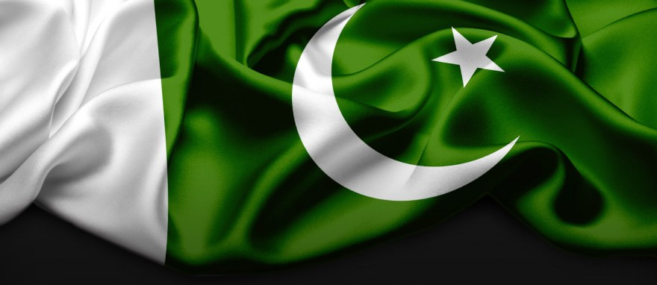
National – Institutions, Instruments & Processes

Slide 77
NATIONAL – PAKISTAN - INSTITUTIONS
FEDERAL MINISTRIES
Ministry of Maritime Affairs (MoMA)
Principal ministry overseeing Pakistan’s maritime policy, ports, shipping, marine pollution, ship registration, marine resources and blue economy policies
Ministry of Climate Change & Environmental Coordination (MoCC)
Leads national environmental policy including marine biodiversity, coastal resilience, pollution control, marine protected areas (MPAs), climate adaptation for coastal zones and mangroves
Ministry of Defence (MoD)
Responsible for maritime security and surveillance through the Pakistan Navy and Maritime Security Agency (MSA), oversees protection of maritime zones
Ministry of Foreign Affairs (MoFA)
Handles international UNCLOS, maritime boundaries, and ocean-related treaties and diplomacy
Ministry of Science and Technology (MoST)
Supports research through institutes like National Institute of Oceanography (NIO) and PCSIR
Ministry of Commerce
Regulates marine trade, exports (seafood), and trade-related aspects of maritime law (WTO, fisheries subsidies)
Ministry of Planning, Development & Special Initiatives
Develops policy for blue economy, coastal development and CPEC-related maritime infrastructure

Slide 78
NATIONAL – PAKISTAN - INSTITUTIONS
Port and Shipping Authorities
Karachi Port Trust (KPT)
Operates Karachi Port; involved in coastal management, maritime logistics, and port-related pollution control.
Port Qasim Authority (PQA)
Second major port; handles industrial marine infrastructure, shipping, and environmental compliance.
Gwadar Port Authority (GPA)
Manages Gwadar Port; strategic for blue economy, regional trade, and coastal development under CPEC

Slide 79
NATIONAL – PAKISTAN - INSTITUTIONS
Specialized Maritime & Ocean Institutions
Pakistan Maritime Security Agency (PMSA)
Enforces maritime law, prevents illegal fishing, and protects marine environment within EEZ.
National Institute of Oceanography (NIO) – under MoST
Premier scientific body conducting research on marine resources, ecosystems, pollution, and climate impact on oceans.
Pakistan Navy – Hydrographic Department
Responsible for hydrographic surveys, nautical charts, and maritime domain awareness.
Marine Fisheries Department (MFD) – under MoMA
Regulates marine fisheries, licensing, data collection, and policy for sustainable fishing.
Fisheries Development Board (FDB) – under MoNFS&R
Supports aquaculture, seafood value chain, and blue economy initiatives.
Pakistan National Shipping Corporation (PNSC)
State-owned shipping line, promoting marine logistics, ship registry, and marine manpower.

Slide 80
NATIONAL – PAKISTAN - INSTITUTIONS
Research, Academia & Environment
Pakistan Council for Science and Industrial Research (PCSIR)
Conducts applied research including on marine biotechnology, pollution, and materials from sea.
Pakistan Environmental Protection Agency (Pak-EPA) – under MoCC
Enforces marine pollution laws (e.g., under MARPOL), EIAs, and regulates port and coastal developments.
Pakistan Meteorological Department (PMD)
Provides oceanographic and coastal weather forecasting, tsunami early warning.
Space & Upper Atmosphere Research Commission (SUPARCO)
Supports maritime domain awareness via satellite imagery, coastal erosion monitoring.
Centre of Excellence in Marine Biology (CEMB), University of Karachi
Academic research center focused on marine ecosystems, fisheries, and biodiversity.
Bahria University (National Institute of Maritime Affairs – NIMA)
Offers maritime law, ocean governance, and naval strategy education and research.

Slide 81
NATIONAL – PAKISTAN - INSTITUTIONS
Training and Capacity Building
Pakistan Marine Academy (PMA)
Trains merchant navy officers and seafarers per international maritime standards.
Karachi Shipyard & Engineering Works (KSEW)
Builds and repairs naval and commercial vessels; linked to industrial marine policy.
Intergovernmental / Coordination Platforms
Maritime Affairs Coordination Committee (MACC) (proposed / ad hoc basis)
Inter-ministerial coordination on maritime security, blue economy, and UNCLOS compliance (when functional).
Pakistan Blue Economy Task Force (proposed / under formulation)
Multi-stakeholder task force for developing a national blue economy framework.
Cross-Cutting/Supportive Institutions
Board of Investment (BOI) – Attracts investment in coastal/marine industries
Federal Board of Revenue (FBR) – Regulates maritime customs, port taxes.
Pakistan Coast Guards – Coastal security and anti-smuggling enforcement.
National Disaster Management Authority (NDMA) – Manages marine and coastal disaster response (tsunamis & cyclones)

Slide 82
INTERNATIONAL INSTRUMENTS – PAKISTAN PARTY
United Nations Instruments
1. UNCLOS 1982 - United Nations Convention on the Law of the Sea
2. UNFSA 1995 - UN Agreement on Straddling Fish Stocks and Highly Migratory Fish Stocks
3. CBD 1992 - Convention on Biological Diversity
4. BBNJ Agreement 2023 (not yet ratified) - Biodiversity Beyond National Jurisdiction Agreement
5. UNFCCC 1992 - United Nations Framework Convention on Climate Change
IMO Conventions (Key Instruments Ratified by Pakistan)
6. SOLAS 1974 - International Convention for the Safety of Life at Sea
7. MARPOL 73/78 - International Convention for the Prevention of Pollution from Ships
8. STCW 1978 - International Convention on Standards of Training, Certification, and Watch-keeping for Seafarers
9. SAR 1979 - International Convention on Maritime Search and Rescue
10. OPRC 1990 - International Convention on Oil Pollution Preparedness, Response and Co-operation
11. BWM 2004 - Ballast Water Management Convention
12. AFS 2001 - Anti-Fouling Systems Convention
13. Hong Kong Convention 2009 - International Convention for the Safe and Environmentally Sound Recycling of Ships
14. COLREG 1972 - Convention on International Regulations for Preventing Collisions at Sea
15. LLMC 1976 & Protocol 1996 - Convention on Limitation of Liability for Maritime Claims
16. CLC 1969 & Protocols - International Convention on Civil Liability for Oil Pollution Damage
17. FUND 1971 & Protocols (1992/2003) - International Fund for Compensation for Oil Pollution Damage
18. BUNKERS 2001 - Convention on Civil Liability for Bunker Oil Pollution Damage
19. SUA 1988 & Protocols - Convention for the Suppression of Unlawful Acts against the Safety of Maritime Navigation
Other Relevant International Instruments
20. FAO Port State Measures Agreement (PSMA) (Accession status: Observed but not yet ratified)
21. ILO Maritime Labour Convention (MLC 2006) (Not ratified yet)
22. Regional Cooperation Agreement on Combating Piracy (ReCAAP) (Pakistan is not yet a member but observer)

Slide 83
INSTRUMENTS - NATIONAL PAKISTAN
Constitutional & Administrative Framework
Constitution of the Islamic Republic of Pakistan, 1973
Article 172(2) – Ownership of natural resources in sea, and Legislative List – Subjects like shipping, navigation, fisheries, ports, marine pollution
Rules of Business, 1973
Defines distribution of responsibilities among federal ministries
Core Maritime Laws
Territorial Sea and Maritime Zones Act, 2023
Defined Pakistan’s maritime zones (territorial sea, EEZ, continental shelf).
Merchant Shipping Ordinance, 2001
Governs ship registration, safety, crew certification, marine accidents, liability, and compliance with IMO instruments
Admiralty Jurisdiction of High Courts Ordinance, 1980
Provides jurisdiction to High Courts for civil maritime claims like salvage, collisions, charter parties, and marine insurance
Pakistan Maritime Security Agency Act, 1994
Establishes PMSA for enforcing laws in Pakistan’s EEZ and adjacent waters, including anti-piracy, IUU fishing, and marine pollution control
Pakistan National Shipping Corporation Ordinance, 1979
Legal framework for the operation of Pakistan’s state-owned commercial fleet

Slide 84
INSTRUMENTS - NATIONAL PAKISTAN
Port Authorities & Coastal Infrastructure Laws
Karachi Port Trust Act, 1886
Governs administration and regulation of Karachi Port.
Port Qasim Authority Act, 1973
Establishes PQA as a statutory authority to manage port Bin Qasim
Gwadar Port Authority Ordinance, 2002
Framework for development, operations, and governance of Gwadar Port
Customs Act, 1969 (relevant to port and maritime trade enforcement)
Marine Resources, Fisheries & Environment
Exclusive Fisheries Zone (Regulation of Fishing) Act, 1975
Sindh Fisheries Ordinance, 1980
Balochistan Sea Fisheries Ordinance, 1971
All Regulate fishing in respective areas, licensing, prohibited gear, and conservation
Pakistan Aquaculture Development Act (Proposed/drafted)
Expected to regulate marine aquaculture
Environment Protection Act, 1997
Enforces marine environmental standards, marine EIAs, pollution control and coastal impact assessments
Biodiversity Act, 2023 (Draft/Proposed)
Likely to cover marine biodiversity conservation in future

Slide 85
INSTRUMENTS - NATIONAL PAKISTAN
Policies and Strategic Documents
Maritime Policy of Pakistan (Drafted/Adopted)
Outlines strategic direction on ports, shipbuilding, fisheries, blue economy, and maritime security.
National Fisheries Policy, 2018 (Draft)
Aims to promote sustainable fisheries, aquaculture, and marine livelihoods.
Pakistan Climate Change Policy, 2012 (updated 2021)
Includes climate risks to coastal areas, sea-level rise, mangrove restoration, and ocean acidification.
National Maritime Security Policy, 2022 (Strategic level)
Addresses threats in the maritime domain including illegal fishing, pollution, smuggling, and defense.
Blue Economy Roadmap of Pakistan (Under consultation/launch phase)
Multi-sectoral strategy for sustainable use of ocean resources and marine spatial planning

Slide 86
INSTRUMENTS - NATIONAL PAKISTAN
Institutional & Regulatory Framework
Coastal Development Authorities Acts
Sindh Coastal Development Authority Act, 1994
Balochistan Coastal Development Authority Act, 1998
Promote coastal area development, eco-tourism, and infrastructure in coastal belts
Pakistan Marine Academy Rules & Regulations
For training and certification of seafarers under STCW
Pakistan National Shipping Corporation Regulations
For ship acquisition, manning, and commercial operations.
Pakistan Maritime Zones (Baselines) Notification, 2009
Demarcates baseline points for calculating Pakistan’s maritime zones under UNCLOS.
Maritime Labour Convention, 2006 (MLC) Implementation Rules (notified by MoMA)
Regulates seafarers’ rights and shipboard working conditions.
Relevant Rules, Manuals, and Model Regulations
Pakistan Ports Security Rules, 2004 (ISPS implementation)
MARPOL Rules & Port Reception Facilities Manual
Ballast Water Management Rules (under BWM Convention, MoMA/NIO)
Marine Pollution Contingency Plan (MPCP 2007) (under OPRC Convention)
Fisheries Management Plans (Sindh & Balochistan)
EIA Regulations for Coastal Development (under PEPA)

Slide 87
Ocean Governance – Pakistan’s Efforts & Initiatives
Ratification of Key International Conventions like UNCLOS 1982, MARPOL 73/78, SOLAS 1974, STCW 1978, SAR 1979, BWM 2004, and recently ratified Hong Kong Convention (2023)
Enactment of Territorial Waters and Maritime Zones Act, 2023
Strengthening Maritime Security through PMSA Act, 1994
Establishment of Ministry of Maritime Affairs (MoMA)
National Institute of Oceanography (NIO)
Development of Blue Economy Vision and National Maritime Policy Ratification of IMO Instruments and Implementation through the Merchant Shipping Ordinance, 2001
Environmental Protection through PEPA, 1997 and EIAs for Coastal Projects
Creation of Coastal Development Authorities
Participation in UN and Regional Maritime Forums

Slide 88
Deficiencies & Gaps

Slide 89
Ocean Governance – Pakistan’s Deficiencies and Gaps
Gaps & Deficiencies in Pakistan’s Oceans Governance
Lack of Integrated Ocean Policy or Marine Spatial Planning (MSP)
Weak Enforcement of IUU Fishing and Fisheries Management
Non-Ratification of the Maritime Labour Convention (MLC 2006)
Underdeveloped Institutional Capacity
Absence of National Marine Protected Areas (MPAs) Network
Limited Participation in Regional Fisheries Management Organizations (RFMOs)
Slow Implementation of Climate and Biodiversity Commitments in Coastal Areas
Insufficient Pollution Control from Ports and Shipping
Lack of Indigenous Hydrographic Survey Capacity
Delayed or Fragmented Legislation on Emerging Areas (Deep Sea Mining, Ocean Acidification)
A half cooked and half hearted effort in enactment of Maritime Zones Act, 2023

Slide 90
Way Forward & Conclusion

Slide 91
INSTRUMENTS - NATIONAL & LOCAL
Active participation of UNO, IMO and their legal instruments, technical bodies, and partner initiatives have laid the foundation for effective ocean governance—covering safety, security environmental sustainability, fair trade, seafarer welfare, marine science, and capacity building.
In the context of Pakistan, aligning national laws, institutions, and policies with international maritime frameworks is critical for safeguarding national interests and contributing to global ocean stewardship
Ocean governance is driven by: Regional institutions, International frameworks, and Shared challenges and solutions
The way forward requires: Better legal harmonization, Integrated maritime domain awareness, Strengthening regional scientific cooperation, and Inclusive blue economy planning

Slide 92
To conclude, I leave you with a profound lesson:
that true governance of our oceans begins not just with
policy, but with responsibility — shared, sustained, and sincere
A LAWYER MAY NOT KNOW WHAT IS LAW
BUT
HE MUST KNOW WHERE IS LAW

Slide 93



Slide 94
